Slide 1
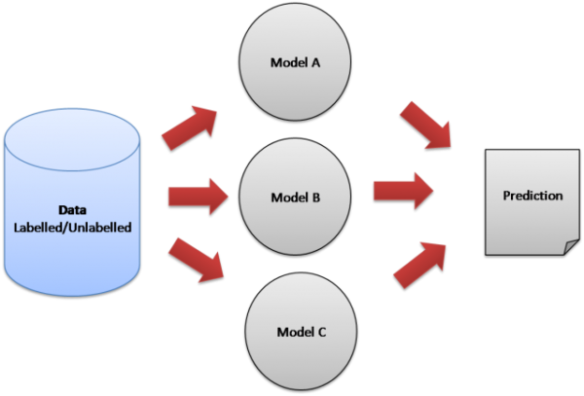
Ensemble learning

Slide 2
Example
Bootstrap
aggregating
Data 1
Data 4
Data 3
Data 1
Data 2
Data 3
Data 4
Data 5
Data 6
Data 7
Data 8
Model 1
-1
Data 2
Data 2
Data 5
Model 2
1
1
Data 8
Data 7
Data 8
Model 3
1
Out of bag = Data 6

Slide 3
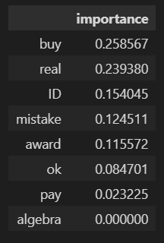
Is Random forest just another algorithm in out tool box?
feature_importances = pd.DataFrame(rfc.feature_importances_, index= X_train.columns, columns=['importance']).sort_values('importance', ascending = False)

Slide 4
Google Colab – Google Drive
from google.colab import drive
drive.mount('/content/drive')

Slide 5
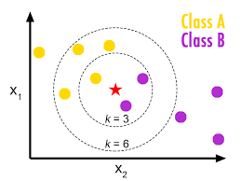
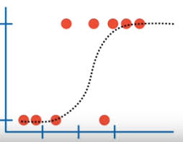
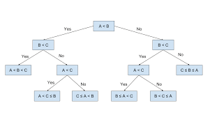
It is time for new classfication algorithm

Slide 6
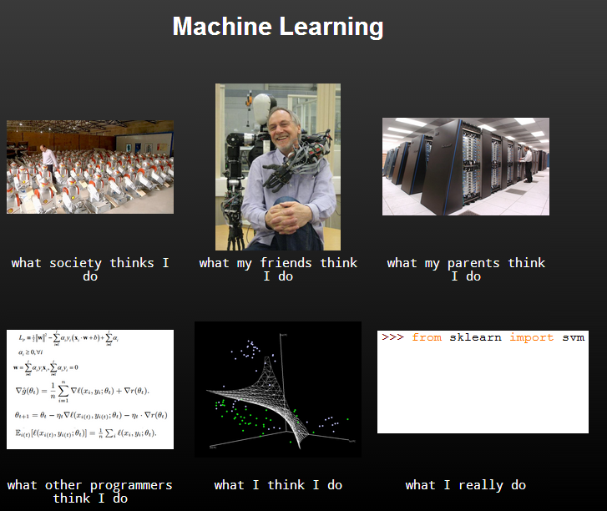

Slide 7
Support vector machines SVM
A small introduction to classification
A small introduction to classification
Machine Learning Methods
Notes:
Ažurirati naziv kolegija.

Slide 8
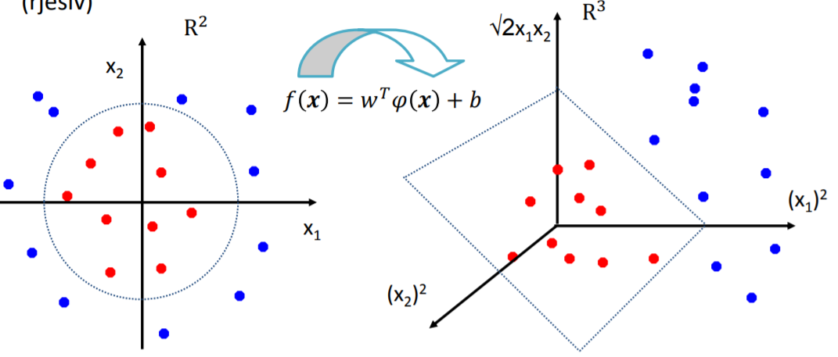

Slide 13
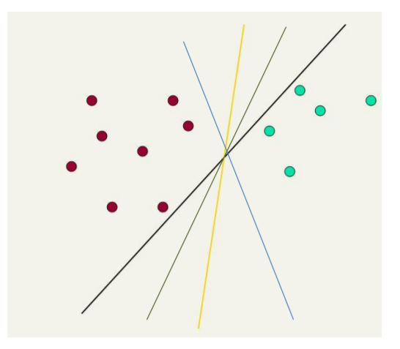

Slide 14
Decision boundary is linear!
F2
F1

Slide 15
On a wrong side.
F2
F1

Slide 16
On a wrong side.
F2
On a wrong side.
F1

Slide 17
F2
On a wrong side.
F1

Slide 18
F2
On a OK side.
F1

Slide 19
On a wrong side.
F2
F1

Slide 20
F2
On a wrong side.
F1

Slide 21
F2
On a wrong side.
F1

Slide 22
On a wrong side.
F2
F1

Slide 23
On a wrong side.
F2
F1

Slide 24
F2
On a wrong side.
F1

Slide 25
F2
On a wrong side.
F1

Slide 26
Step 1: Start with random line
Step 2: Pick a large number (1000)
Step 3: Pick a small number (0.01)
Step 4: repeat 1000 times
Pick random point
If point is correctly classified:
do nothing
If point is incorrectly classified
move line towards point

Slide 27
F2
F1

Slide 28
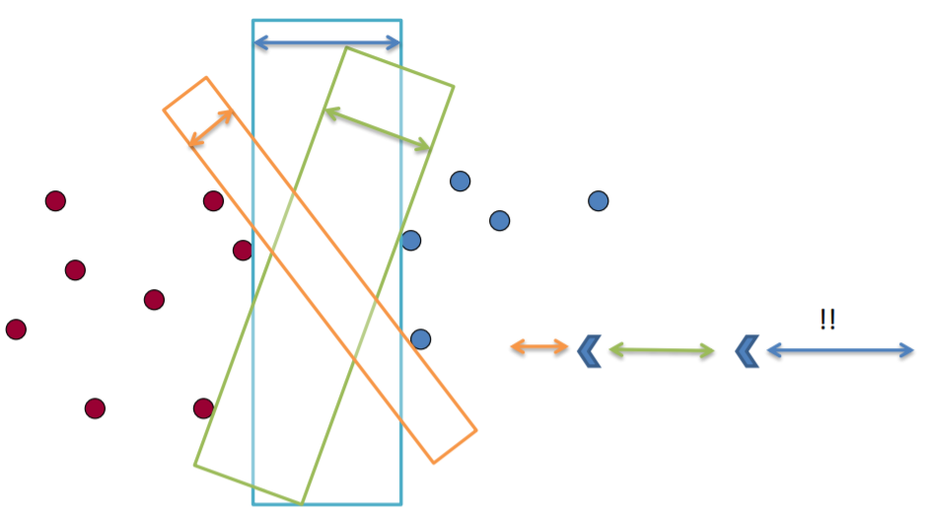

Slide 29
F2
F1

Slide 30
On a wrong side.
F2
F1

Slide 31
F2
On a wrong side.
F1

Slide 32
F2
F1

Slide 33
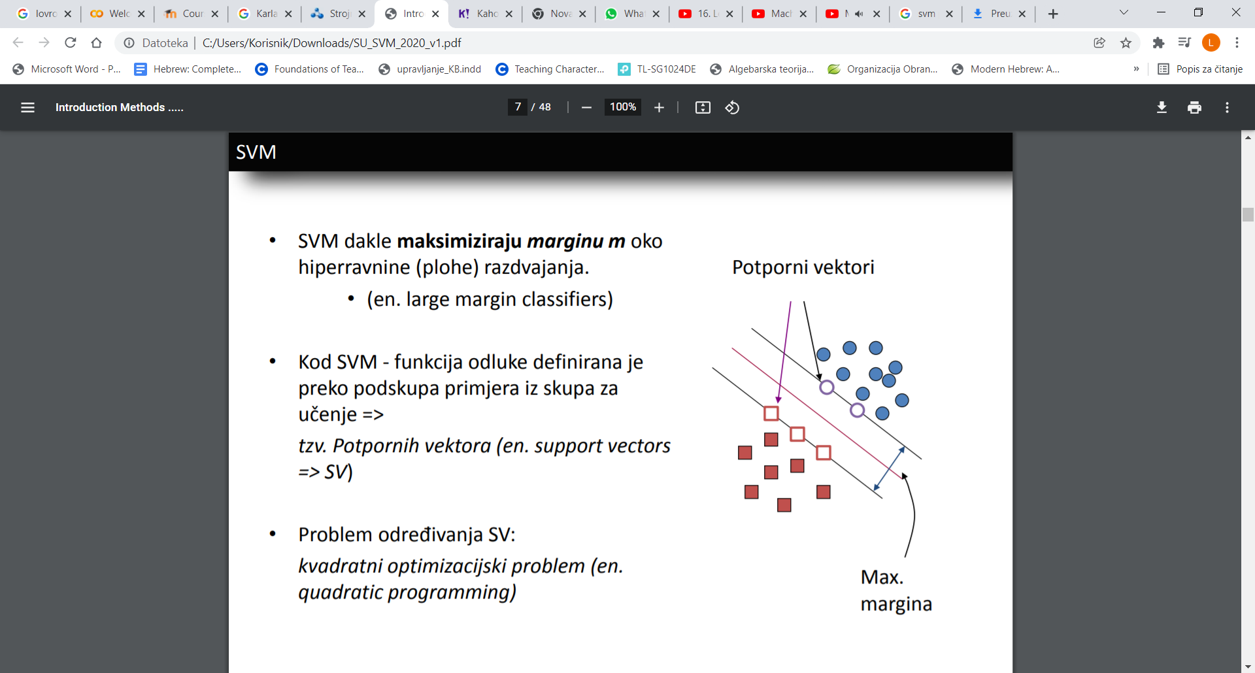
Support vectors
Maximum margin

Slide 34
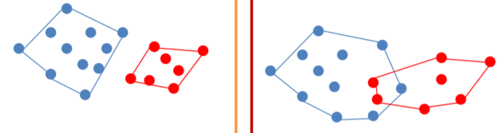
What if we can’t find a linear direction that would separate the classes?

Slide 36
X
-3
-2
0
2
3
5
8
10

Slide 37
X
-3
-2
0
2
3
5
8
10
X*X
9
4
0
4
9
25
64
100

Slide 38
X | Y
3 | 3
2 | 1
1 | 3
1 | 4
2 | 3
1 | 1
4 | 4

Slide 39
X | Y
3 | 3
2 | 1
1 | 3
1 | 4
2 | 3
1 | 1
4 | 4
X*X | Y*Y
9 | 9
4 | 1
1 | 9
1 | 16
4 | 9
1 | 1
16 | 16

Slide 40
X | Y
3 | 3
2 | 1
1 | 3
1 | 4
2 | 3
1 | 1
4 | 4
X*X | Y*Y
9 | 9
4 | 1
1 | 9
1 | 16
4 | 9
1 | 1
16 | 16
X*X + Y*Y
18
5
10
17
13
2
32

Slide 41
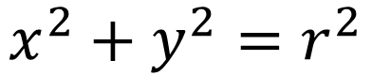
X | Y
3 | 3
2 | 1
1 | 3
1 | 4
2 | 3
1 | 1
4 | 4
X*X | Y*Y
9 | 9
4 | 1
1 | 9
1 | 16
4 | 9
1 | 1
16 | 16
X*X + Y*Y
18
5
10
17
13
2
32
$$x^{2}+y^{2}=r^{2}$$
equation of the circle

Slide 43
import pandas as pd
from sklearn.svm import SVC
from sklearn.model_selection import train_test_split
from sklearn.metrics import accuracy_score
data = pd.read_csv("spam.csv")
X = data.iloc[:, 1:4].values
y = data.iloc[:, 4].values
X_train, X_test, y_train, y_test = train_test_split(X, y, test_size=0.2, random_state=0)
svm_model = SVC(kernel='linear')
svm_model.fit(X_train, y_train)
y_pred = svm_model.predict(X_test)
accuracy = accuracy_score(y_test, y_pred)
print("Accuracy: ", accuracy)

Slide 44
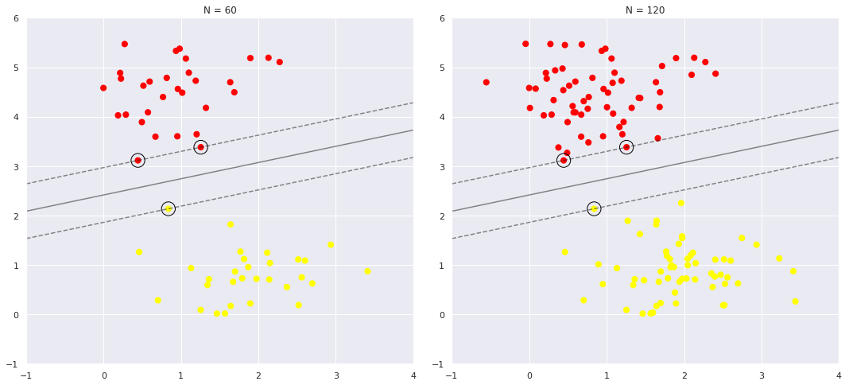
What if it is not possible to find two parallel lines so that no data is between them?

Slide 45
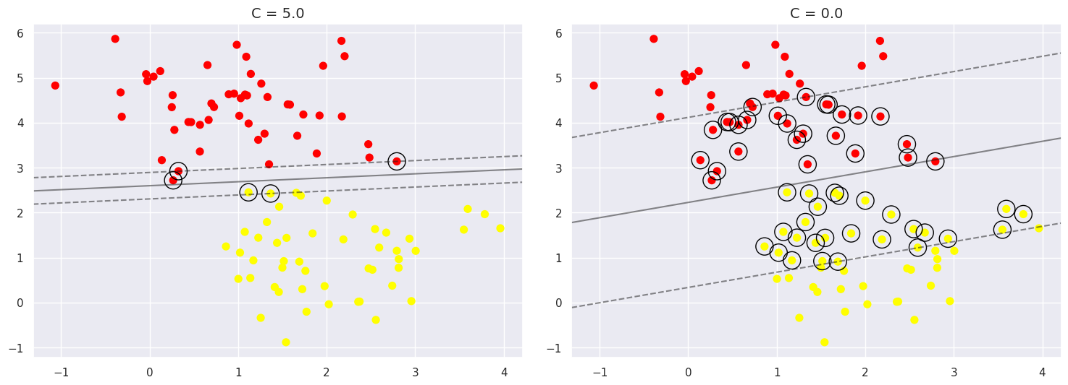

Slide 46
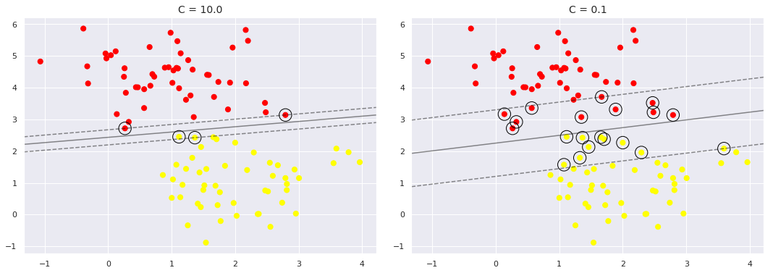

Slide 47
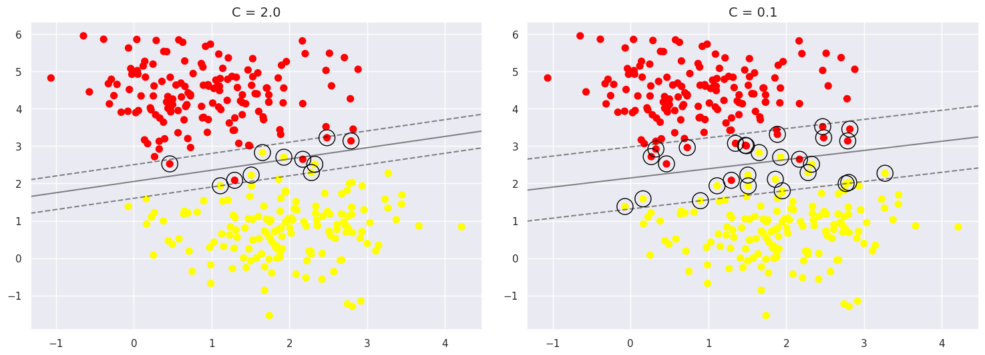

Slide 48
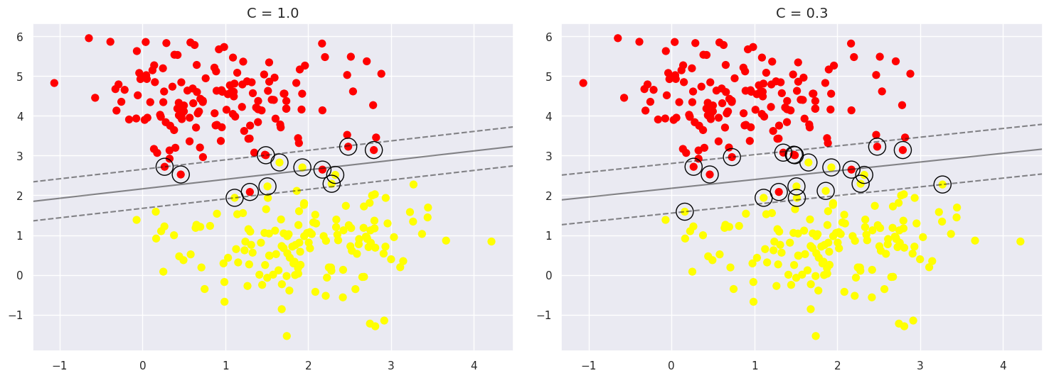

Slide 49
Logistic regression vs linear SVM
Linear SVM is more robust to outliers as it tries to maximize the margin between classes, while logistic regression can be affected by outliers as it tries to minimize the sum of squared errors.
Support vectors

Slide 50
SVR
No or few data between lines
As many points as possible between the lines.
Minimum margin
Maximum margin

Slide 51
Problem
Write an SVM algorithm on the sklearn dataset digits dataset. Perform cross validation on the hyperparameters of the algorithm and compare the accuracy obtained with the accuracy of random noise from last week and explain the results obtained.

Slide 52
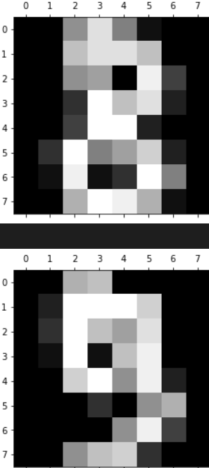
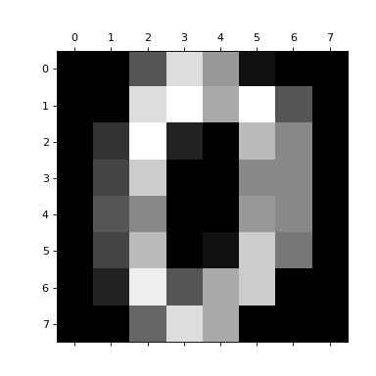
Problem
classification problem of digit recognition
10 classes - (0, 1, 2, ..., 8, 9)
Where are the features that we will insert into our algorithm?

Slide 53
import pandas as pd
from sklearn.datasets import load_digits
import matplotlib.pyplot as plt
digits = load_digits()
df = pd.DataFrame(digits.data)
df['target'] = digits.target
X = df.drop('target',axis='columns')
y = df.target

Slide 54
Thank you for your attention!

